Slide 1
The Higgs Boson Observation
(probably)
Not just another fundamental particle…
Matthew Jones
Purdue University
27-July-2012

Slide 2

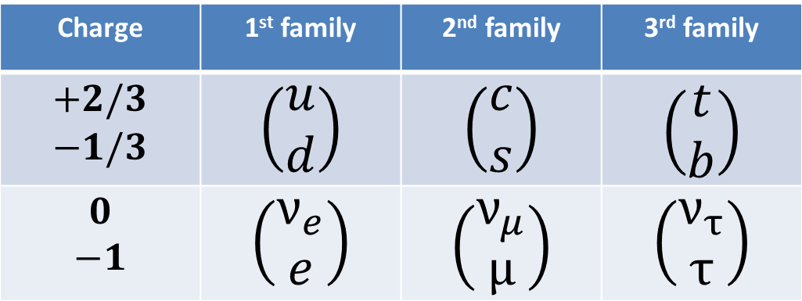
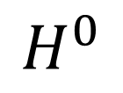
The Standard Model
Charge | 1st family | 2nd family | 3rd family
$$\begin{matrix}+2/3 \\ −1/3\end{matrix}$$ | $$\left(\begin{matrix}u \\ d\end{matrix}\right)$$ | $$\left(\begin{matrix}c \\ s\end{matrix}\right)$$ | $$\left(\begin{matrix}t \\ b\end{matrix}\right)$$
$$\begin{matrix}0 \\ −1\end{matrix}$$ | $$\left(\begin{matrix}ν_{e} \\ e\end{matrix}\right)$$ | $$\left(\begin{matrix}ν_{μ} \\ μ\end{matrix}\right)$$ | $$\left(\begin{matrix}ν_{τ} \\ τ\end{matrix}\right)$$
Quarks
Leptons
$$γ, W^{±}, Z^{0}$$
Gauge bosons
8 gluons
$$H^{0}$$
The Higgs Boson

Slide 3
Why the Higgs Boson?
Quarks:
  Charm quark: 1974
  Bottom quark: 1978
  Top quark: 1994
Leptons:
  Tau lepton: 1975
  Tau neutrino: 2000
Weak Vector Bosons:
  W and Z: 1983
The Higgs boson has been “predicted” to exist for almost 50 years
  Why was it predicted even before we knew about quarks?
  The Standard Model already describes all experimental data with exquisite precision…
  Why do we need/want the Higgs?

Slide 4
Quantum Field Theory in 30 Minutes
Over the years, our description of the most fundamental laws of Nature has evolved…

Slide 5
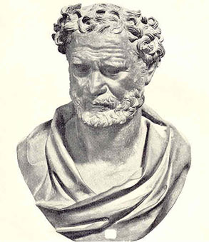
Democritus of Abdera (c. 460-370 BC)
Speculated that matter must ultimately be composed of infinitely small components (atomos)
Just as atoms are supposed to exist, so does the space between them (vacuum)
Atoms would move according to physical laws and not by “divine justice or moral law”.

Slide 6
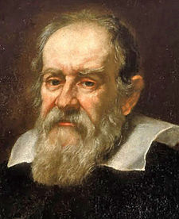
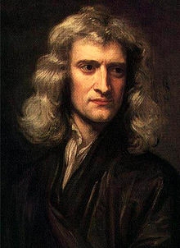
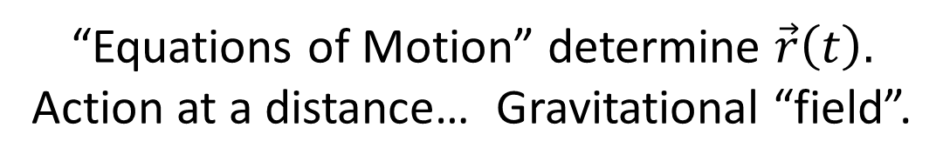
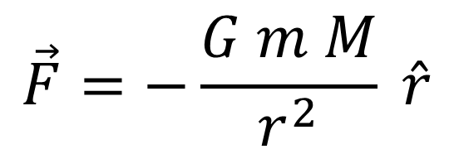
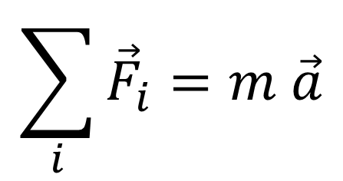
Classical Mechanics
$$\sum_{i}{{\vec{F}}_{i}=m \vec{a}}$$
$$\vec{F}=−\frac{G m M}{r^{2}} \hat{r}$$
“Equations of Motion” determine $\vec{r}\left(t\right).$
Action at a distance… Gravitational “field”.
Special relativity modifies the form of these equations but the idea is the same.

Slide 7
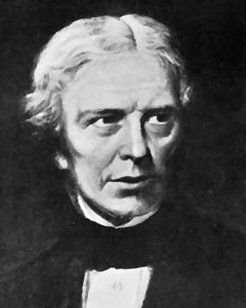
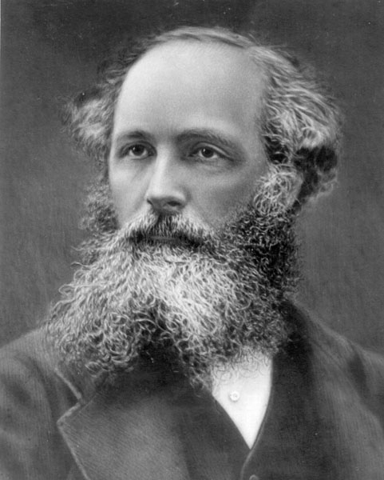
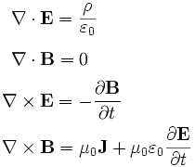
Classical Field Theory
“Equations of Motion” for the field itself!

Slide 8
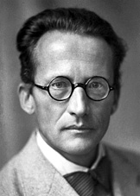
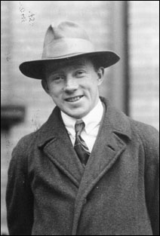
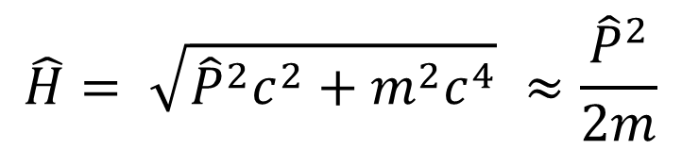
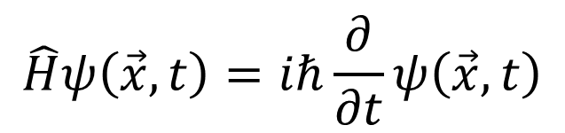
Quantum Mechanics
$$\hat{H}ψ\left(\vec{x},t\right)=iℏ\frac{∂}{∂t}ψ\left(\vec{x},t\right)$$
$$\hat{H}= \sqrt{{\hat{P}}^{2}c^{2}+m^{2}c^{4}} ≈\frac{{\hat{P}}^{2}}{2m}$$
“Equations of Motion” determine the “state” of a particle.
The “state” determines the probability of an observation.
Quantum mechanics + special relativity imply that particles can be created and destroyed which makes calculations awkward.

Slide 9
Quantum Field Theory
The particle is not fundamental – the field is:
  The photon is a quantum excitation of the electromagnetic field
  An electron could be a quantum excitation of the “electron field”
We need equations of motion that tell us what the field is doing at each point in space
  Even if there is no electron, there is still an electron field…
  One, two, or more electrons are just different ways to excite the field.

Slide 10

Example

Slide 11


Example
We can now describe any configuration of electrons in terms of the field, at each point in space, as a function of time.
The excitations can come and go, but the field is always there.

Slide 12
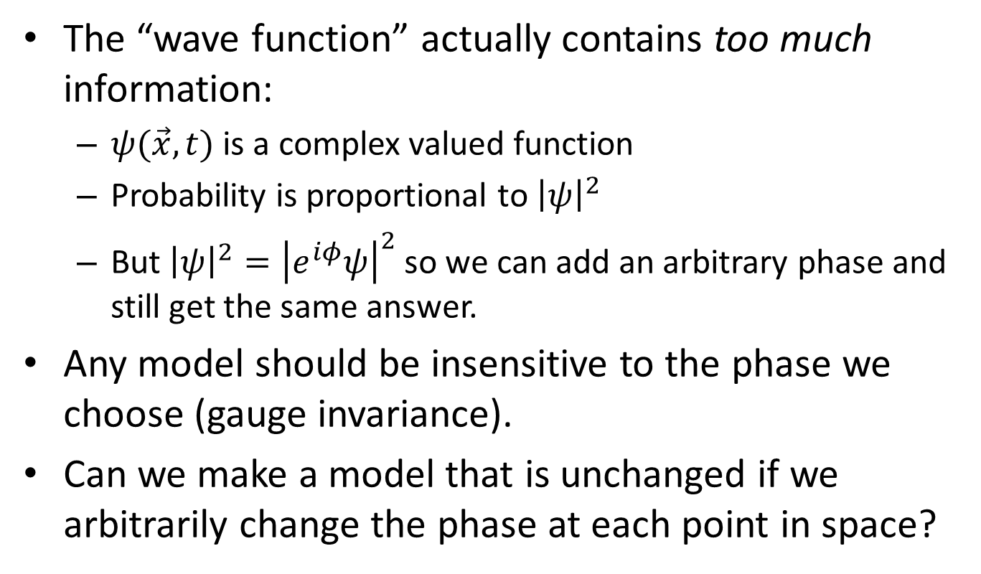
Gauge Invariance
The “wave function” actually contains too much information:
  $ψ(\vec{x},t)$ is a complex valued function
  Probability is proportional to ${\left|ψ\right|}^{2}$
  But ${\left|ψ\right|}^{2}={\left|e^{iφ}ψ\right|}^{2}$ so we can add an arbitrary phase and still get the same answer.
Any model should be insensitive to the phase we choose (gauge invariance).
Can we make a model that is unchanged if we arbitrarily change the phase at each point in space?

Slide 13
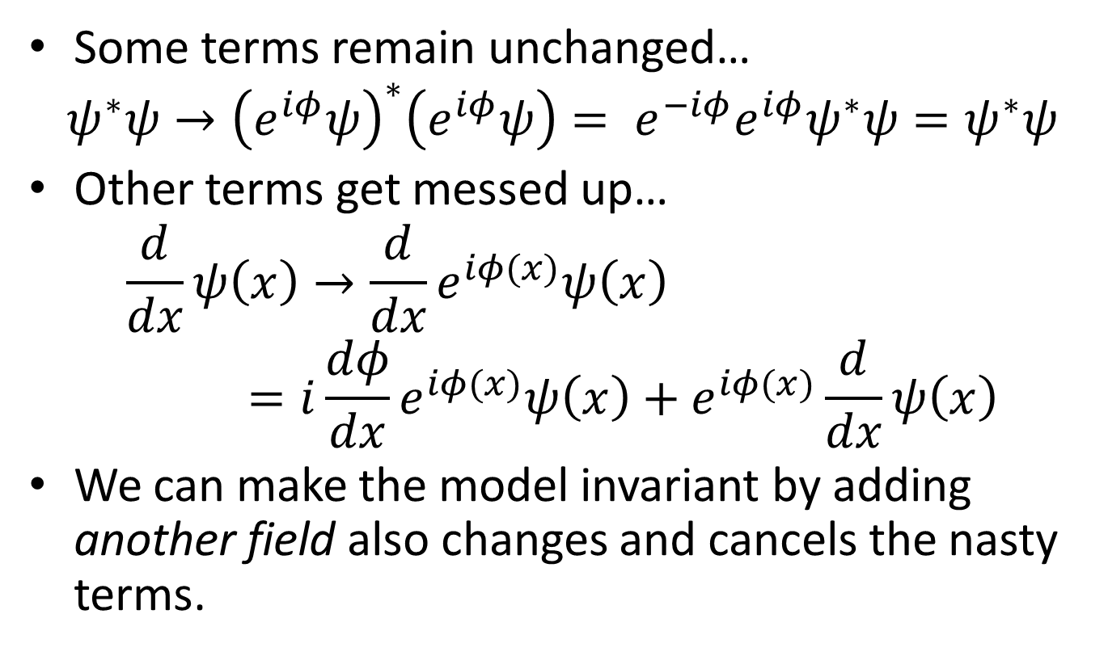
Gauge Invariance
Some terms remain unchanged…
$$ψ^{∗}ψ→{\left(e^{iφ}ψ\right)}^{∗}\left(e^{iφ}ψ\right)= e^{−iφ}e^{iφ}ψ^{∗}ψ=ψ^{∗}ψ$$
Other terms get messed up…
$$\frac{d}{dx}ψ\left(x\right)→\frac{d}{dx}e^{iφ(x)}ψ\left(x\right)=i\frac{dφ}{dx}e^{iφ(x)}ψ\left(x\right)+e^{iφ(x)}\frac{d}{dx}ψ\left(x\right)$$
We can make the model invariant by adding another field also changes and cancels the nasty terms.

Slide 14
Gauge Invariance
The extra field has to be spin-1 for this to work
  We call it a “gauge boson”
  It also has to be massless.
Its interaction with an electron field is completely constrained except for an unknown constant
  But we can measure it in an experiment
It has all the properties of the electromagnetic field.
  The constant is the charge of an electron
This is Quantum Electrodynamics:
  the relativistic quantum field theory of electrons, positrons and photons.

Slide 15
Quantum Chromodynamics
Quarks carry one of three “color charges”
  But we can’t observe them directly… the hadrons are colorless combinations of quarks.
We can define how to label the colors differently at each point in space.
To keep the model unchanged we have to add new particles:
  We need to add 8 of them
  We call them “gluons”
  They must have spin-1
  They must be massless
As far as we can tell, they are…
This seems to be a perfect description of the strong force

Slide 16
Weak Interactions
QED and QCD work so well that we use these ideas to describe other “symmetries”…
As far as the weak interaction is concerned, the up and down quarks are the same.
  We can tell them apart by means of their electric charge, but the weak force doesn’t care about electric charge.
Same with the electron and the electron neutrino
  We can tell them apart because they have different mass and charge, but the weak interaction doesn’t care.

Slide 17
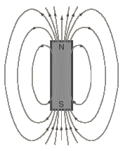
Example
The electron (spin ½) looks like a little magnet:
In quantum mechanics it can be in one of two states: up or down
  Remember the hydrogen atom and Pauli’s exclusion principle?
Either way, we still call it an electron and nature might not care which way we label as “up”.

Slide 18
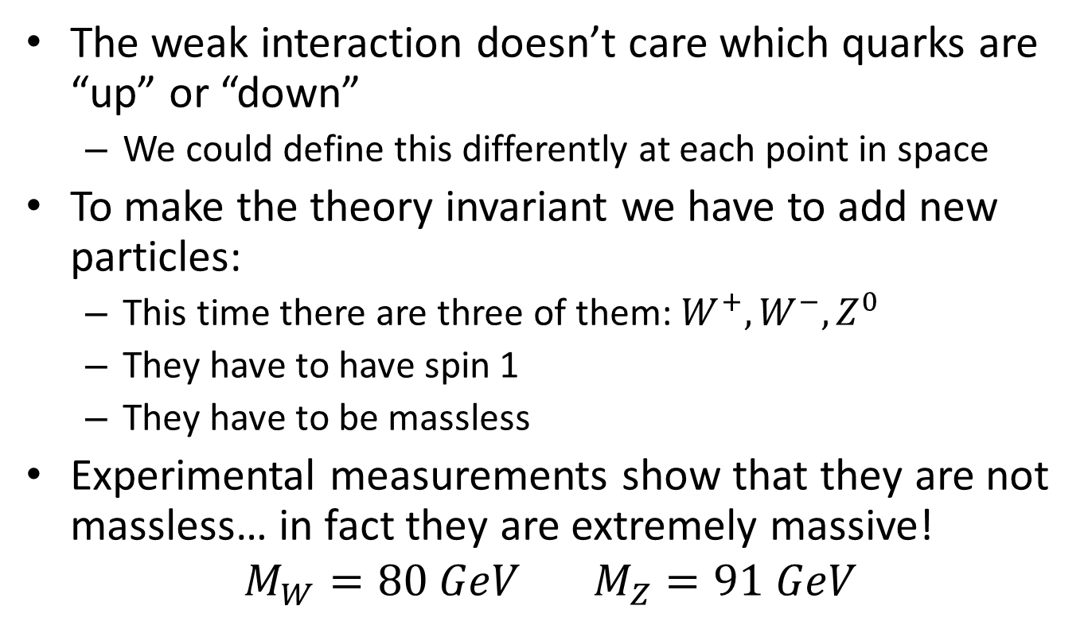
Weak Interactions
The weak interaction doesn’t care which quarks are “up” or “down”
  We could define this differently at each point in space
To make the theory invariant we have to add new particles:
  This time there are three of them: $W^{+}, W^{−}, Z^{0}$
  They have to have spin 1
  They have to be massless
Experimental measurements show that they are not massless… in fact they are extremely massive!
$$M_{W}=80 GeV M_{Z}=91 GeV$$

Slide 19
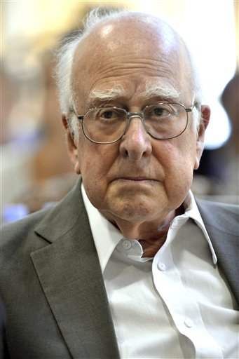
The Higgs Mechanism (1968)
Suppose the weak gauge bosons really were massless
Add another set of fields that they interact with which gives the same effect as mass:
  A massless particle travels at the speed of light
  Massless particles that “stick” to the Higgs field are slowed down
  Photons and gluons don’t couple to the Higgs field so they remain massless.
But, we need to find a non-zero Higgs field at each point in space,
  While keeping the whole model gauge invariant…
  How can we do this?

Slide 20
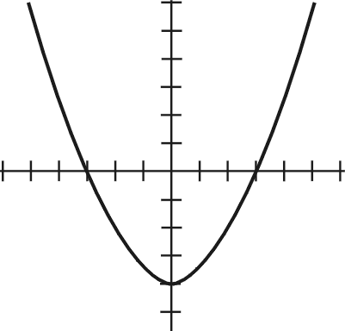



Potential Energy
Interactions ↔ Forces ↔ Potential energy
The lowest energy is at the bottom of a potential well:
In this case the minimum is when $H=0$… no good.
$V(H$)
$$H$$

Slide 21
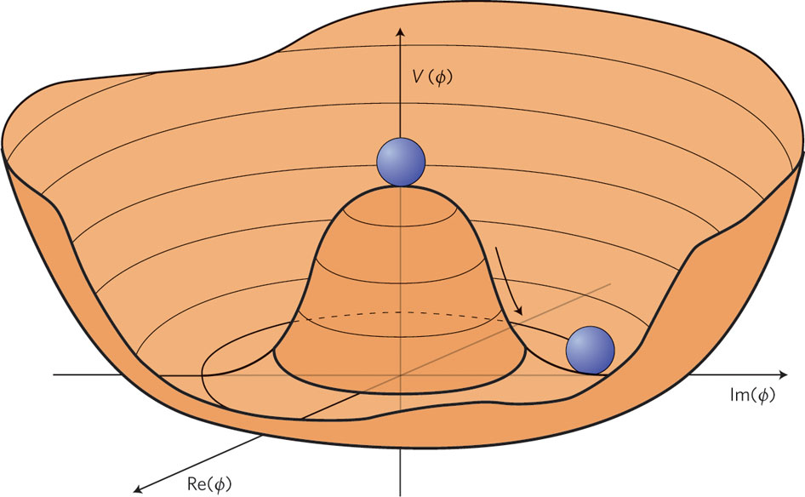
Potential Energy
The potential doesn’t have to be a parabola:
It looks parabolic near the point of minimum energy
This time, the field is not zero!
  We call this the “vacuum expectation value”

Slide 22
The Standard Model
Start with massless quarks and leptons
Group them into up-down pairs
Add massless gauge bosons
Add a Higgs field
  Give it a potential energy with a non-zero vacuum expectation value
Voila!
  Massive quarks and leptons
  Massive gauge bosons

Slide 23
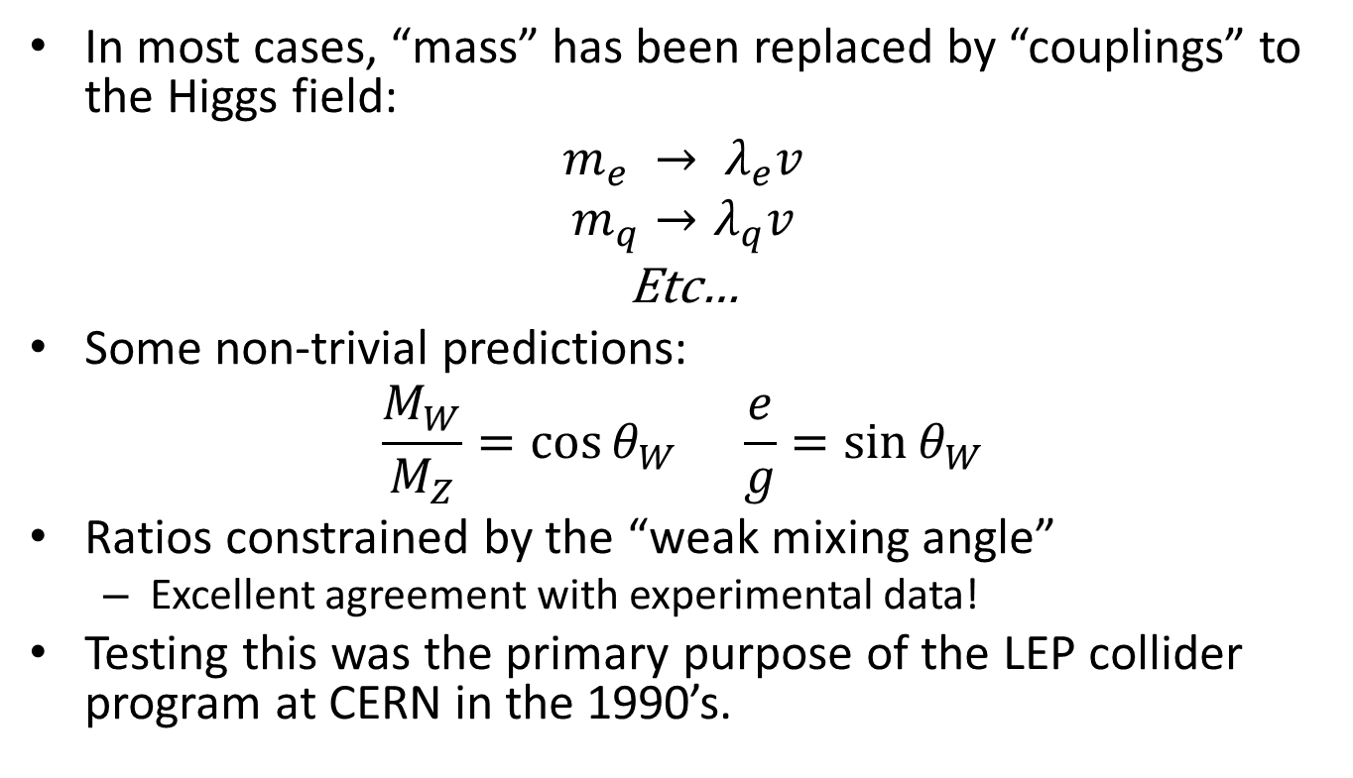
The Standard Model
In most cases, “mass” has been replaced by “couplings” to the Higgs field:
$$m_{e} → λ_{e}v$$
$$m_{q}→λ_{q}v$$
Etc…
Some non-trivial predictions:
$$\frac{M_{W}}{M_{Z}}=\cos{θ_{W}} \frac{e}{g}=\sin{θ_{W}}$$
Ratios constrained by the “weak mixing angle”
  Excellent agreement with experimental data!
Testing this was the primary purpose of the LEP collider program at CERN in the 1990’s.

Slide 24
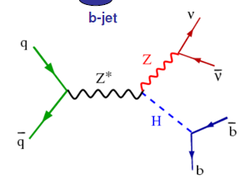
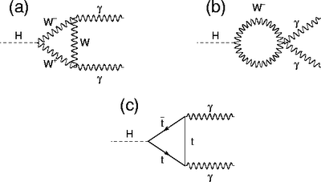
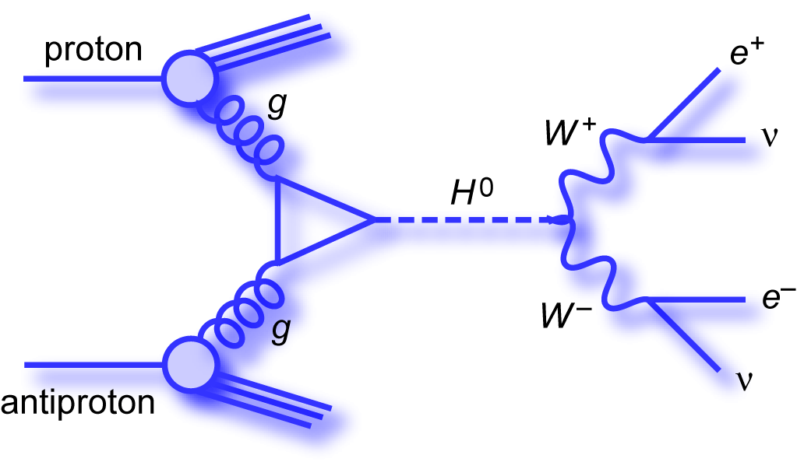



Where’s the Higgs?
If the Higgs field is real, we should be able to excite it and make a Higgs boson
We don’t know its mass…
How it decays depends on its mass… but it likes to couple to heavy things…
t
$$H→W^{+}W^{−}$$
or
$$H→Z^{0}Z^{0}$$
$$H→b\overline{b}$$
$$H→γγ$$

Slide 25
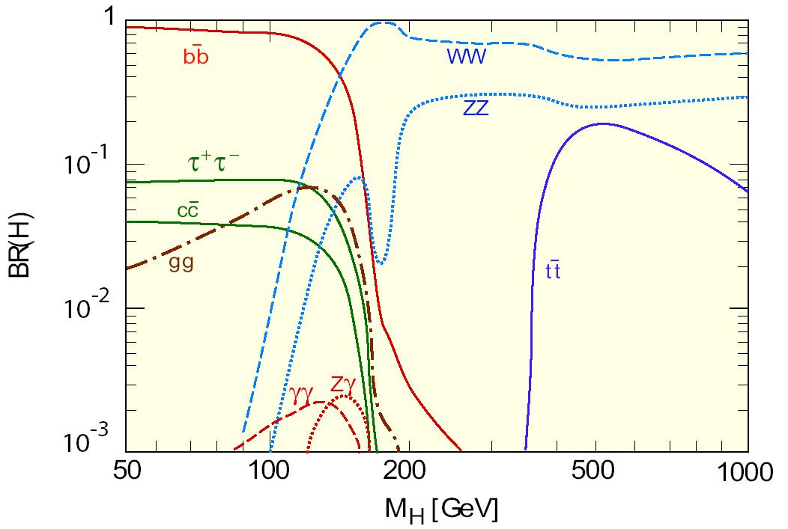
How Would the Higgs Decay?

Slide 26
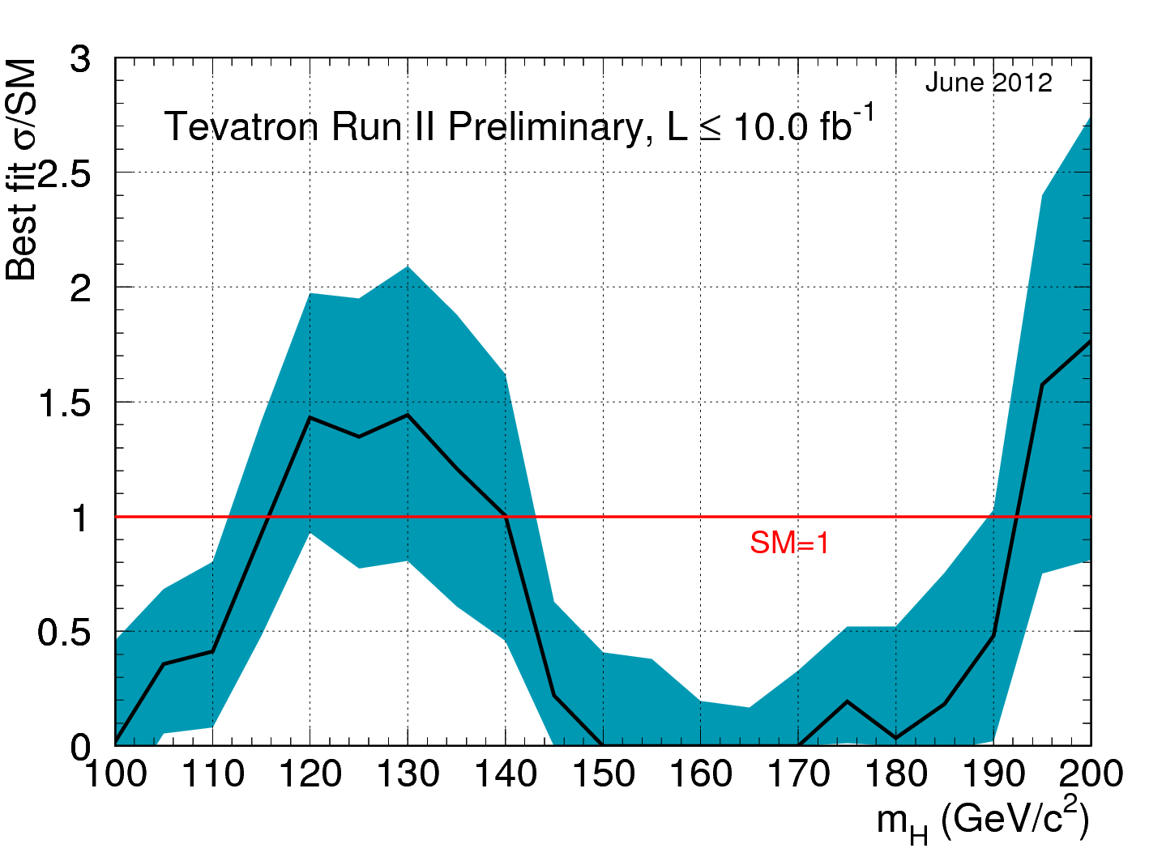
Searches at the Tevatron
Better description of the data

Slide 27
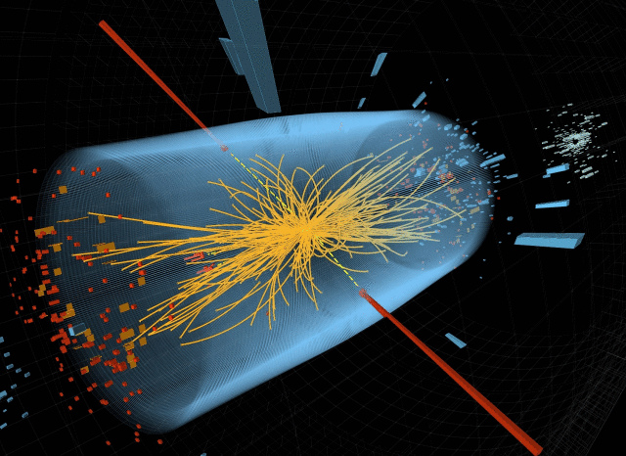

Higgs Searches at the LHC
$H→γγ$ is rare, but very clean:

Slide 28
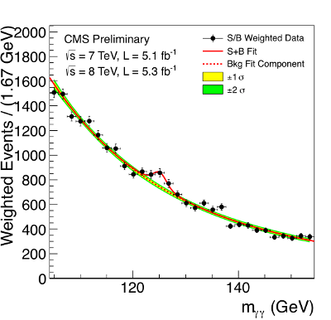
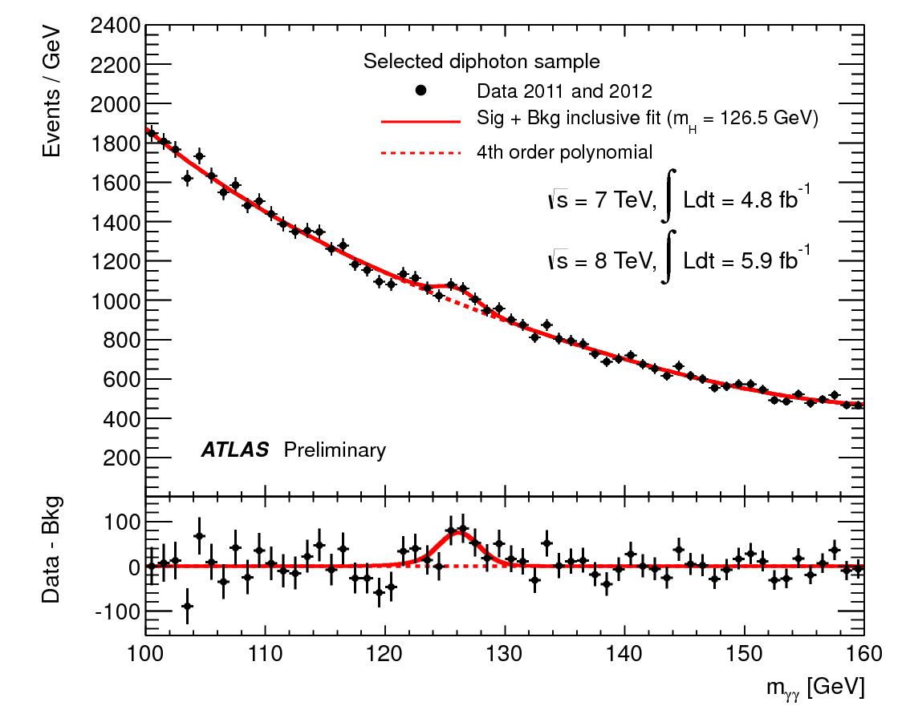


Recent Observation at the LHC
$$M = 125.3 ± 0.4 ± 0.5 GeV$$
$$M \sim 126.5 GeV$$

Slide 29
Is it the Higgs?
How to check?
  Is its coupling strength proportional to mass?
  Is it spin zero?
  Does it decay in all the ways we expect?
Still some open questions:
  The Higgs couples to itself… what keeps the Higgs mass from getting too big?
  Neutrinos do have mass…
  Still no good ideas for quantizing gravity or explaining dark matter
  As usual, we can solve these problems by adding new particles to the theory.
    So far we see no evidence for any of them.

Slide 30
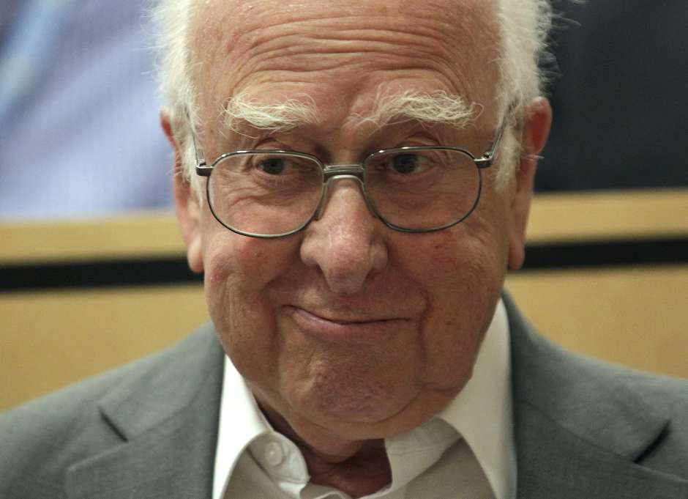
M ≈ 125 GeV

